Slide 1
Accounting and Business
1
1

Slide 2
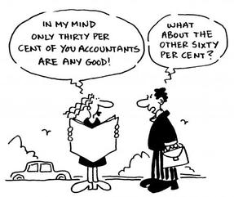
Chapter 1 What is Accounting?
Find a partner and see if you can write down a definition of accounting!

Slide 3
Chapter 1 Definition
Accounting is a of dealing with financial data that provides information for

Slide 4
Chapter 1 The 5 Main Activities
Preparing and collecting permanent records
Rearranging, summarizing and classifying financial information
Establishing controls to promote accuracy and honesty

Slide 5
Chapter 1
Types of Businesses
1. Service Businesses
Examples:
Movie theatre Hair salon Physiotherapy clinic
Accounting firm Catering company
2.
Examples:
Motorcycle dealership Clothing store Video game store
Sporting goods store Grocery store
5

Slide 6
Chapter 1
Types of Businesses
3.
Examples:
Computer manufacturer Car manufacturer
Food-processing company Farm equipment manufacturer
4. Non-Profit Organizations (NPO)
Examples:
Religious organization Charity
Amateur sports organization NGOs (non-governmental organization)
6

Slide 7
Chapter 1
Forms of Business Ownership
1. Sole Proprietorship
Examples:
Dr. Joe Dimitry, Dentist Rosa’s Pizza
Alf’s Home Bakery Rustic Pottery—Miriam Daily, owner
2.
Examples:
McPhearson & Scott, Chartered Accountants
Bucchino & Magalli, Barristers and Solicitors
Hakala and Sons Service Centre
Café Crème—Solange Dion and Alex Boucher, owners
7

Slide 8
Chapter 1
Forms of Business Ownership
3. Limited Company or Corporation
Examples:
Pool People Ltd.
Uni Electrical and Mechanical Ltd.
Gunn’s Auto Service Ltd.
Building Resources Ltd., Construction Consultants
4.
Examples:
Housing cooperatives
Our Ecovillage on Vancouver Island
Worker-owned cooperatives
8

Slide 9
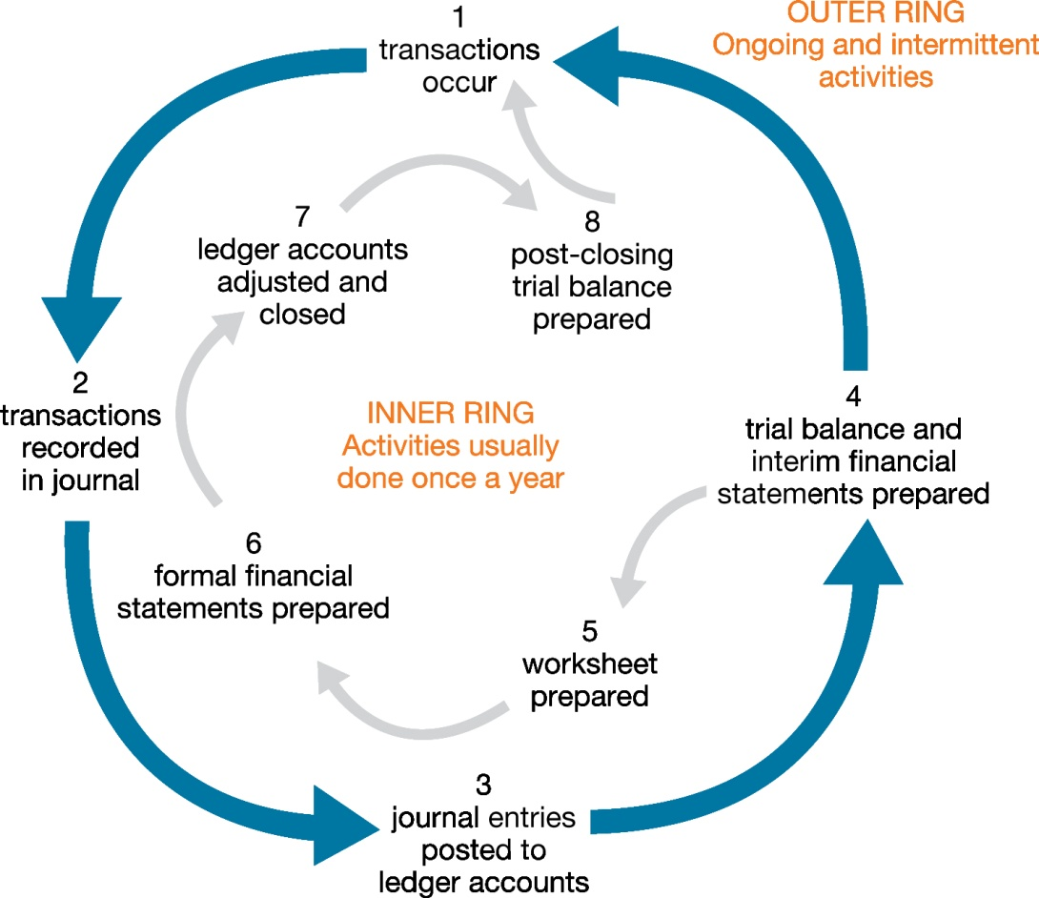
The Accounting Cycle The cycle is complete and it begins to repeat itself.

